Slide 1
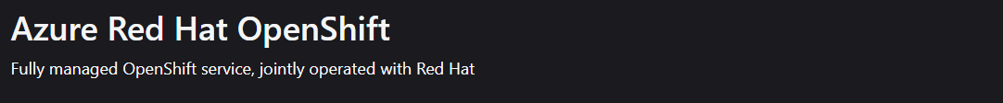
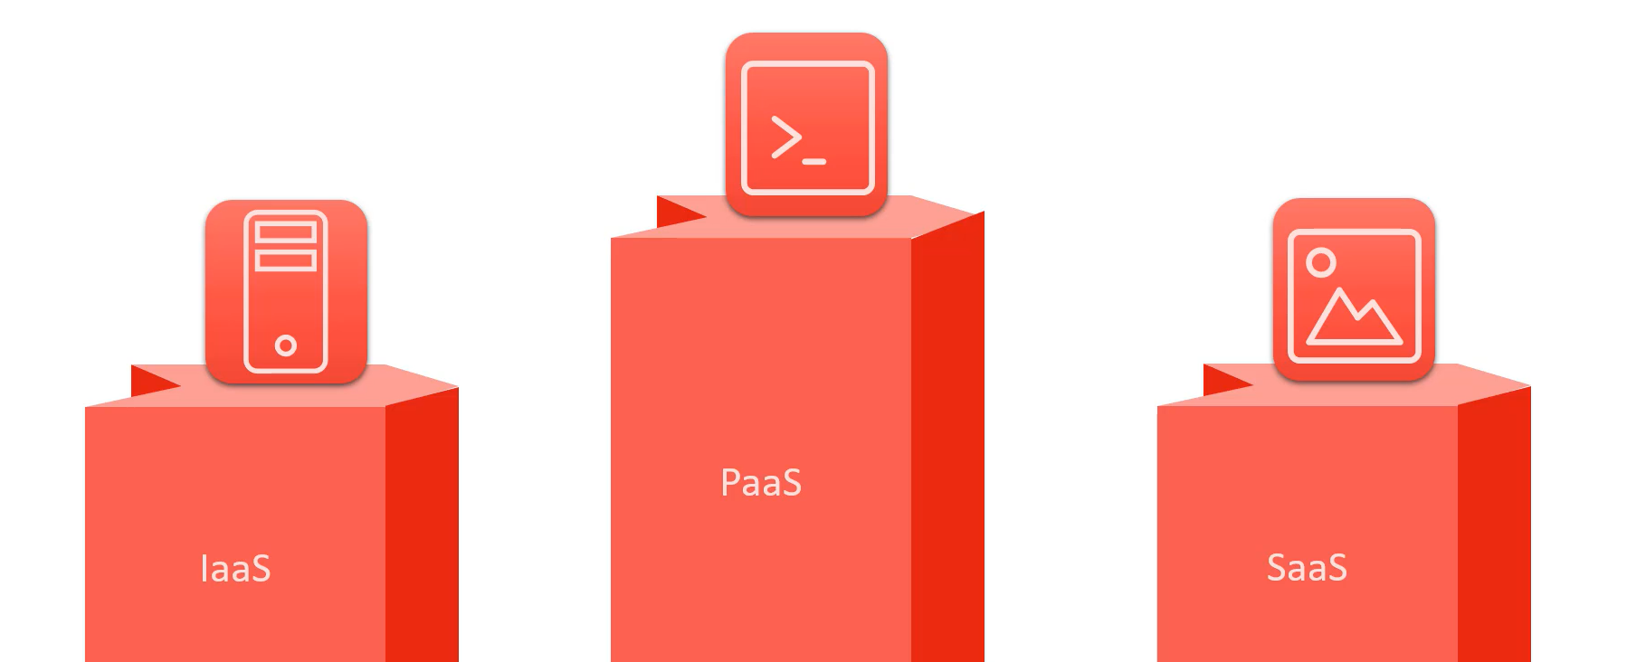

Slide 2
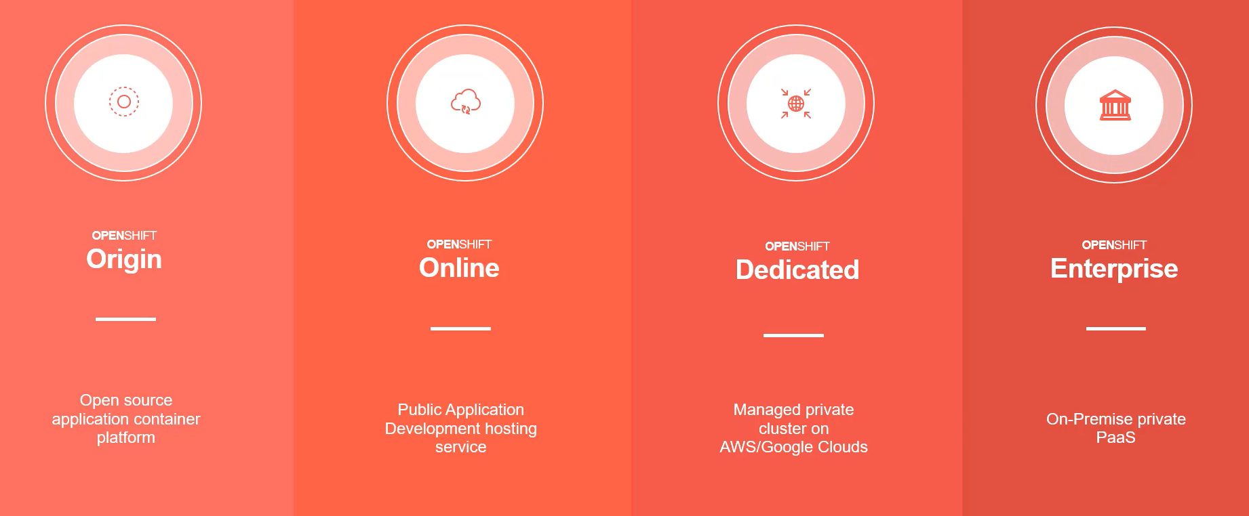

Slide 3
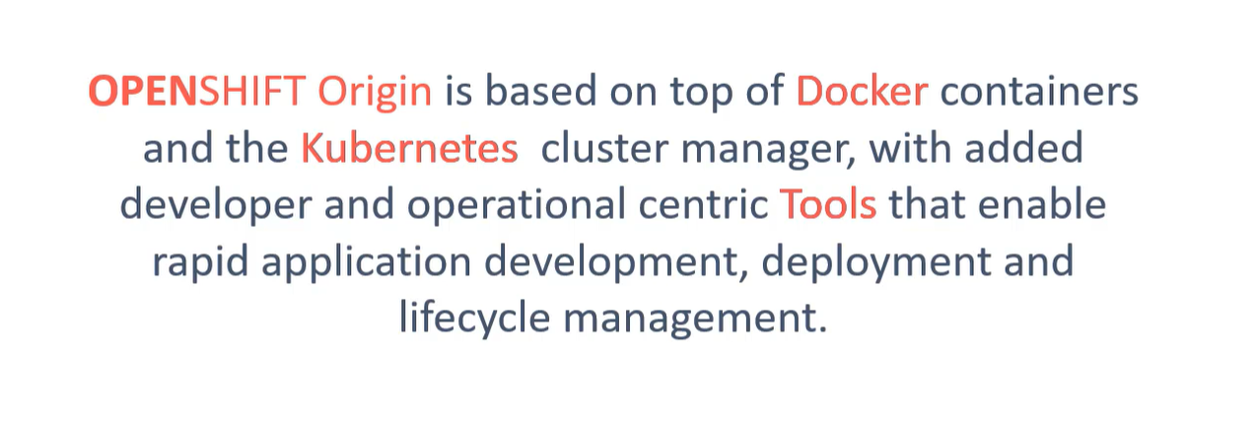

Slide 4
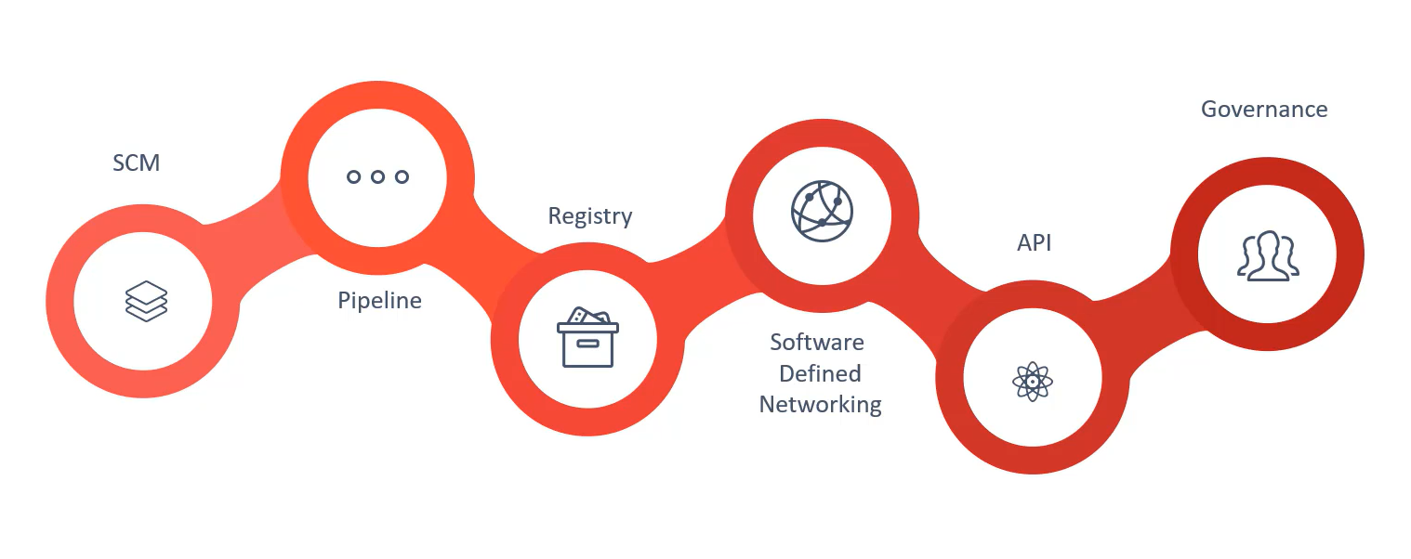

Slide 5
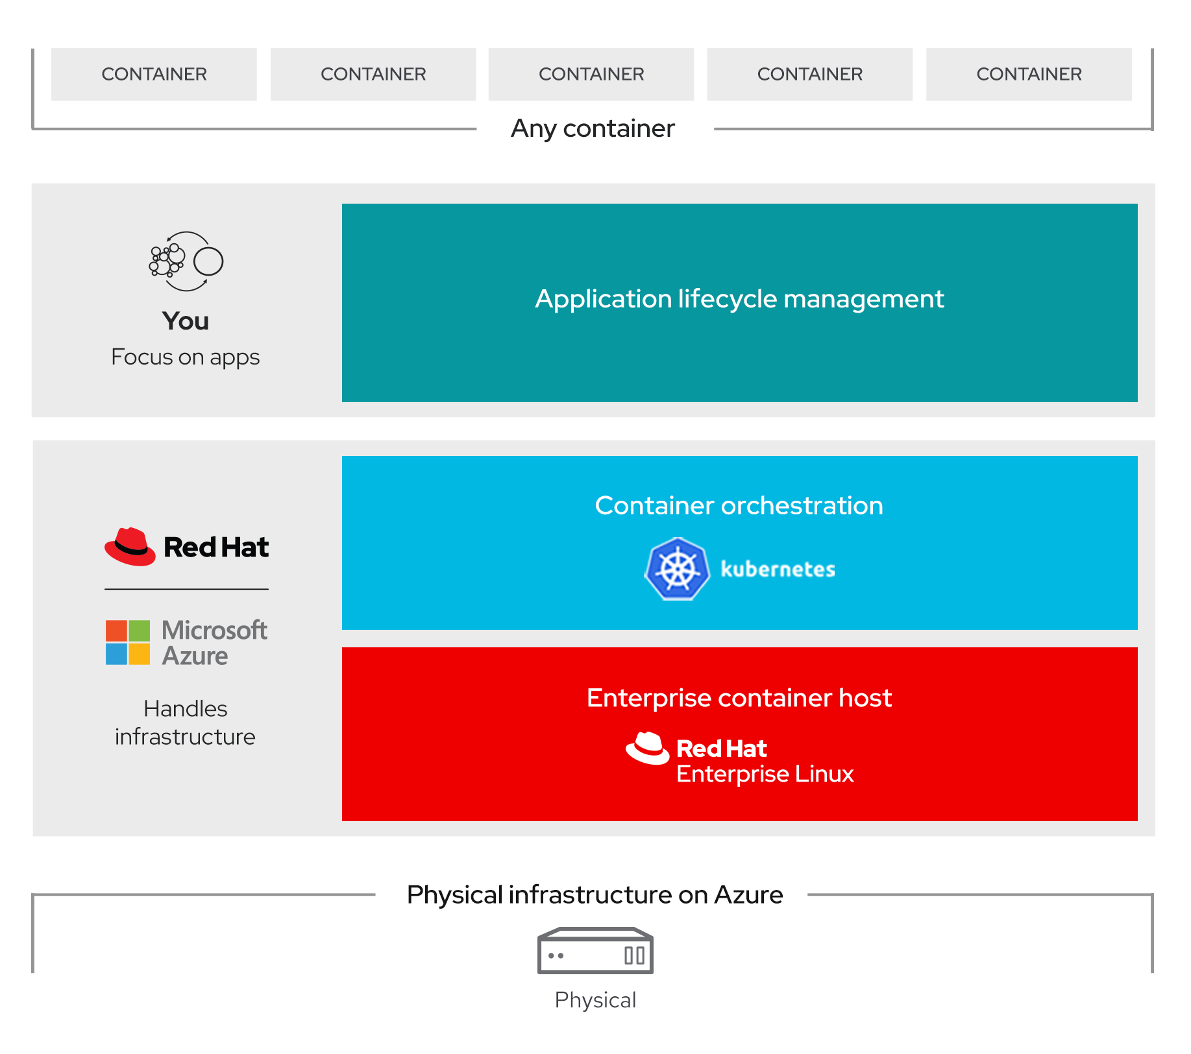
ARO

Slide 6
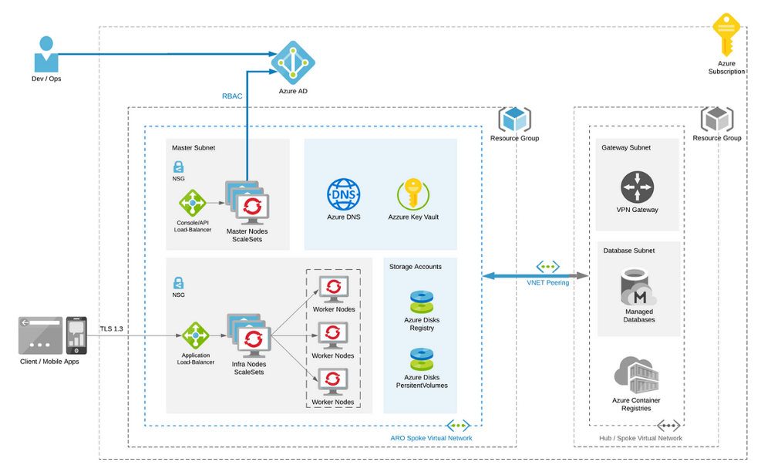

Slide 7
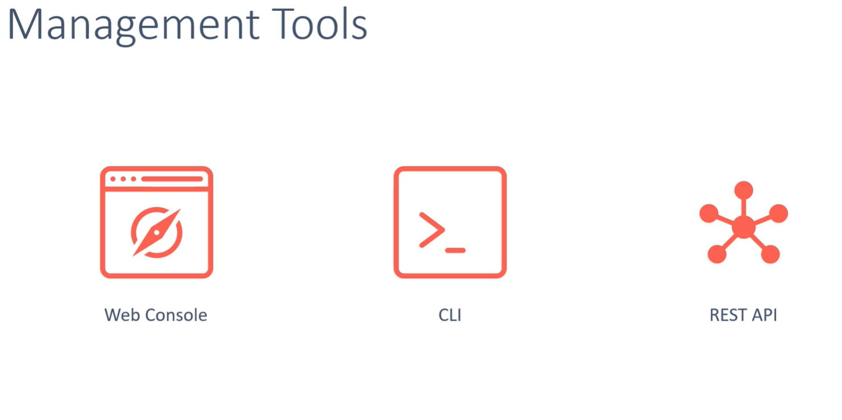

Slide 8
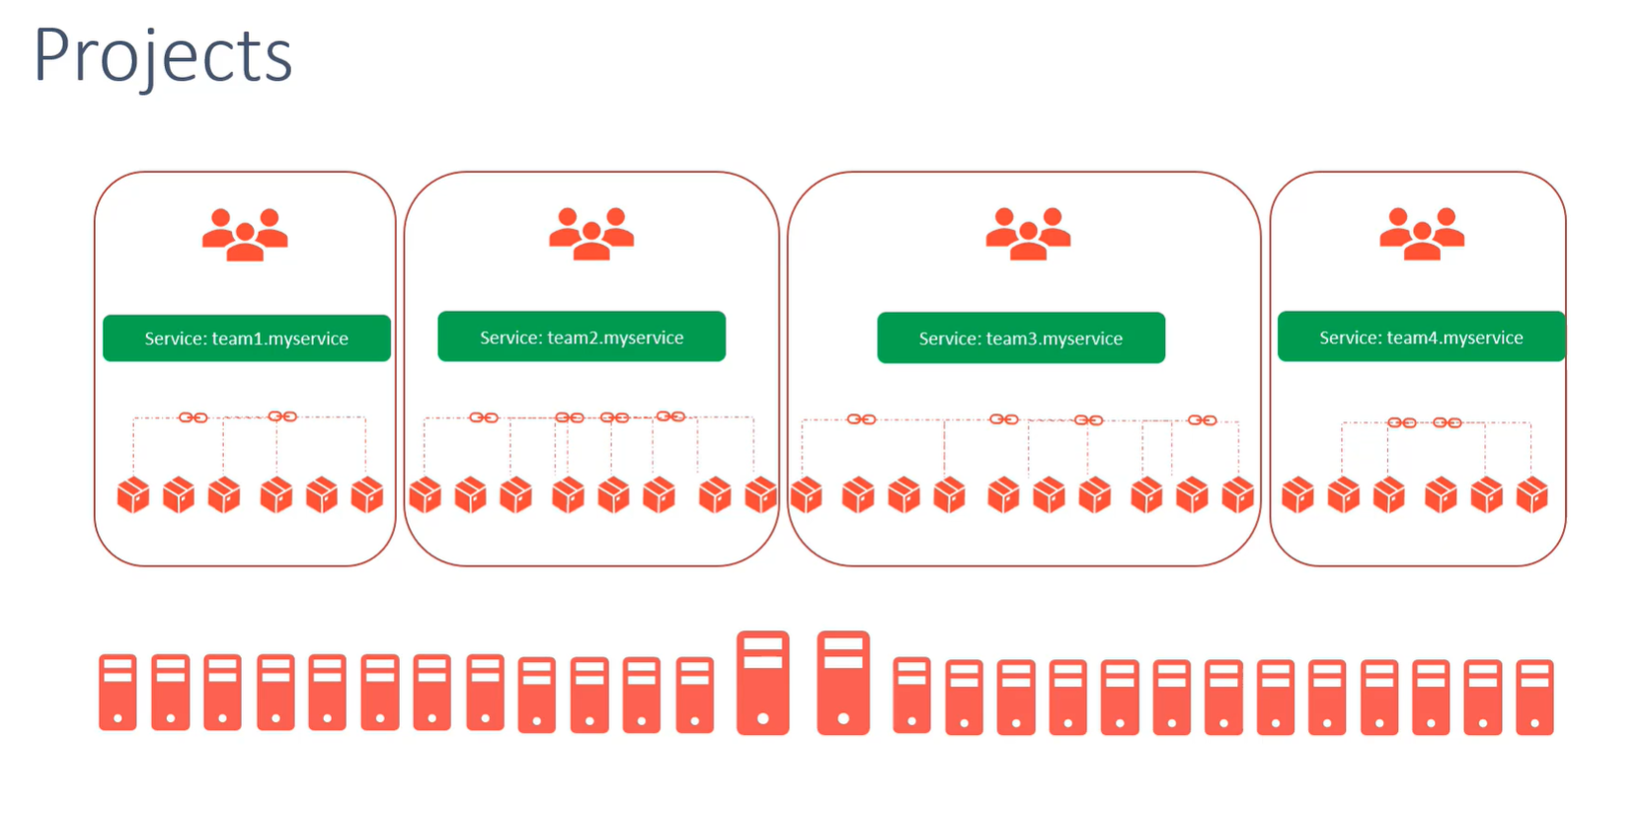

Slide 9
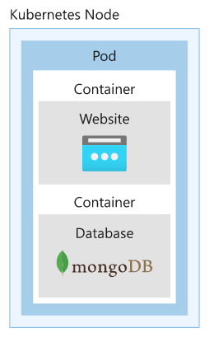
Pods
Kubernetes uses pods to run an instance of your application. A pod represents a single instance of your application. Pods typically have a 1:1 mapping with a container, although there are advanced scenarios where a pod may contain multiple containers.
Services
A service is a Kubernetes object that provides stable networking for pods. A Kubernetes service enables communication between nodes, pods, and users of your application, both internal and external, to the cluster.

Slide 10
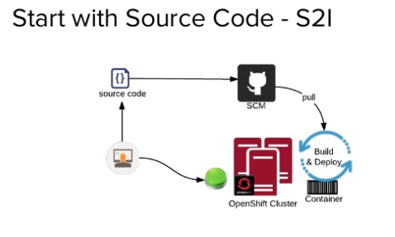
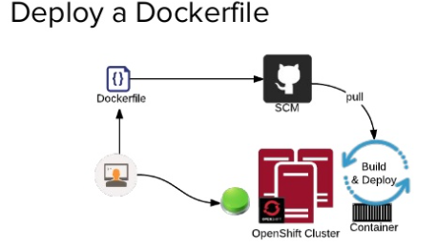
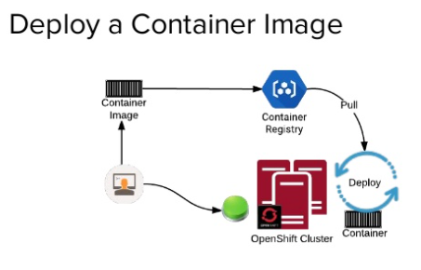

Slide 11
Step-1 Verify your permissions
You must have either Contributor and User Access Administrator permissions, or Owner permissions, either directly on the virtual network, or on the resource group or subscription containing it.
You will also need sufficient Azure Active Directory permissions for the tooling to create an application and service principal on your behalf for the cluster.

Slide 12
Step-2 Register the resource providers
az account set --subscription <SUBSCRIPTION ID>
az provider register -n Microsoft.RedHatOpenShift --wait
az provider register -n Microsoft.Compute --wait
az provider register -n Microsoft.Storage --wait

Slide 14
Step-3 Script to Deploy
LOCATION=eastus
# the location of your cluster
RESOURCEGROUP=Marutiaro-rg
# the name of the resource group where you want to create your cluster
CLUSTER=cluster1
# the name of your cluster

Slide 15
az group create \
--name $RESOURCEGROUP \
--location $LOCATION
az network vnet create \
--resource-group $RESOURCEGROUP \
--name aro-vnet \
--address-prefixes 10.0.0.0/22

Slide 16
az network vnet subnet create \
--resource-group $RESOURCEGROUP \
--vnet-name aro-vnet \
--name master-subnet \
--address-prefixes 10.0.0.0/23 \
--service-endpoints Microsoft.ContainerRegistry
az network vnet subnet create \
--resource-group $RESOURCEGROUP \
--vnet-name aro-vnet \
--name worker-subnet \
--address-prefixes 10.0.2.0/23 \
--service-endpoints Microsoft.ContainerRegistry

Slide 17
az network vnet subnet update \
--name master-subnet \
--resource-group $RESOURCEGROUP \
--vnet-name aro-vnet \
--disable-private-link-service-network-policies true
az aro create \
--resource-group $RESOURCEGROUP \
--name $CLUSTER \
--vnet aro-vnet \
--master-subnet master-subnet \
--worker-subnet worker-subnet

Slide 18
Step-4 Connecting to Cluster
az aro list-credentials \
--name $CLUSTER \
--resource-group $RESOURCEGROUP
#output is
{
"kubeadminPassword": "j55qR-txikY-y3VAN-TPLkU",
"kubeadminUsername": "kubeadmin"
}
https://console-openshift-console.apps.swmul8kz.eastus.aroapp.io/

Slide 19
If you're running the commands on the Azure Cloud Shell, download the latest OpenShift 4 CLI for Linux.
cd ~
wget https://mirror.openshift.com/pub/openshift-v4/clients/ocp/latest/openshift-client-linux.tar.gz
mkdir openshift
tar -zxvf openshift-client-linux.tar.gz -C openshift
echo 'export PATH=$PATH:~/openshift' >> ~/.bashrc && source ~/.bashrc
Retrieve the API server's address.
apiServer=$(az aro show -g $RESOURCEGROUP -n $CLUSTER --query apiserverProfile.url -o tsv)
oc login $apiServer -u kubeadmin -p <kubeadmin password>

Slide 20
Step-5 Delete the Cluster
Delete the cluster
CLUSTER=cluster1
RESOURCEGROUP=Marutiaro-rg
az aro delete --resource-group $RESOURCEGROUP --name $CLUSTER

Slide 21
AKS - ARO

Slide 22
